Slide 1
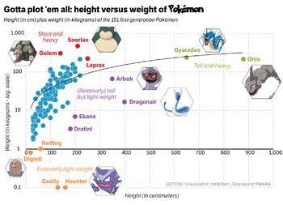
Beginner’s guide to ggplot2
Kirsten Isabel Verster
Data Management & Publishing Series

Slide 2

Itinerary
On the “grammar of graphics”
The syntax and elements of a ggplot2 object
Several practical examples using Pokemon dataset (follow along on https://github.com/kirver/ggplot2)

Slide 3
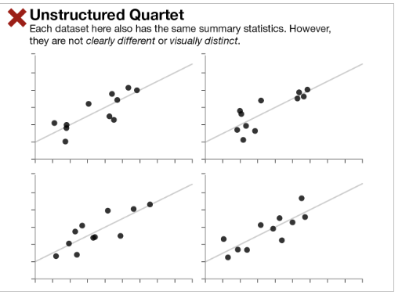
The importance of graphical representation

Slide 4
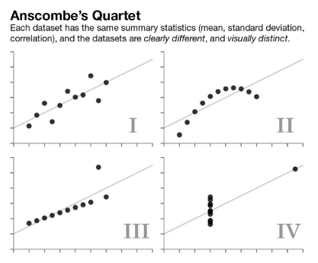
The importance of graphical representation
F.J. Anscombe in 1973: The effectiveness of Anscombe's Quartet is not due to simply having four different datasets which generate the same statistical properties, it is that four clearly different and visually distinct datasets are producing the same statistical properties.
He described it as countering the impression that “numerical calculations are exact, but graphs are rough”.

Slide 5
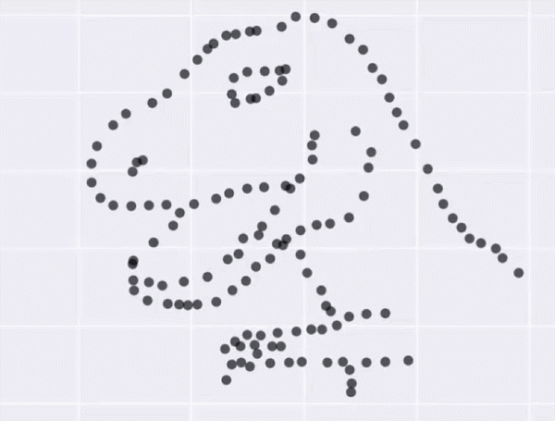
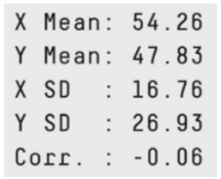
The Datasaurus Dozen
Summary stats are deceptive, make pretty pictures!
Alberto Cairo created the Datasaurus dataset which urges people to "never trust summary statistics alone; always visualize your data“.
tinyurl.com/gg2022sssg
Notes:
Matejka and Fitzmaurice made 200,000 incremental changes to the Datasaurus data set, slightly shifting points so that the summary statistics stayed within one-hundredth of the originals

Slide 6
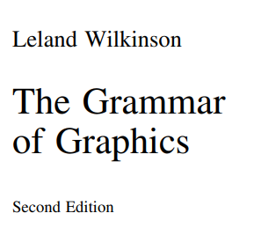
The Grammar of Graphics
Grammar is defined as a set of structural rules which helps define and establish the components of a language
A grammar of graphics is a framework that enables us to concisely describe the components of any graphics
A GOG follows a layered approach by using defined components to build a visualization
The whole system and structure of a language usually consists of syntax and semantics
tinyurl.com/gg2022gog
Notes:
First proposed by Leland Wilkinson

Slide 7
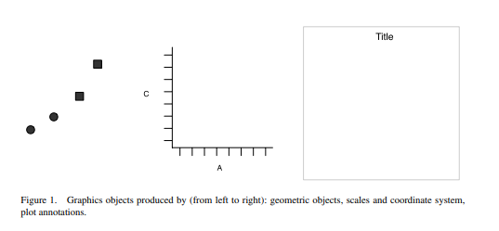
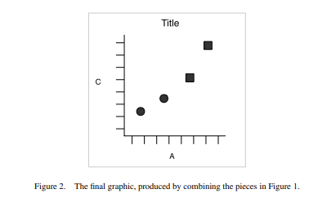
Layered grammar of graphics
Created by Hadley Wickham
https://tinyurl.com/gg2022layered1
Notes:
Table 1 – a simple dataset
A graph is a set of points. A mathematical graph cannot be seen. It is an abstraction. A graphic, however, is a physical representation of a graph. This representation is accomplished by realizing graphs with aesthetic attributes such as size or color.
You can create many different types of plots using these specifications. Line plot. Bar plot. Bars, lines and points are all examples of geometric objects.
To create a combined plot we need to combine graphical obects from these sources: the data, represented by something called geom; the scales and coordinate system, which generates axes and legends so we can read values from the graph; and the plot annotations, such as the background an dplot title.

Slide 8
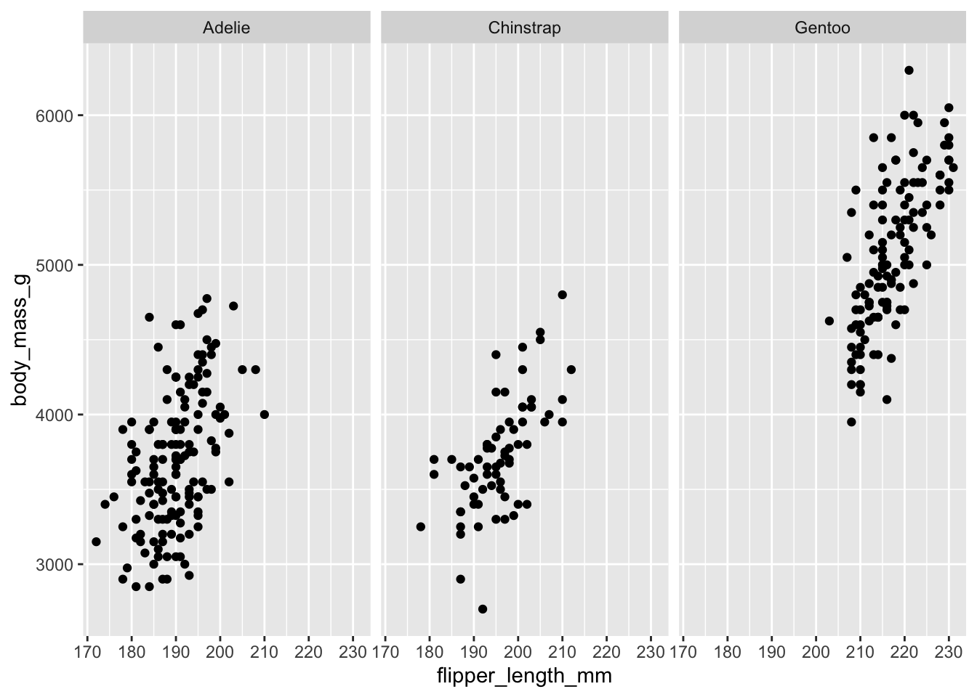
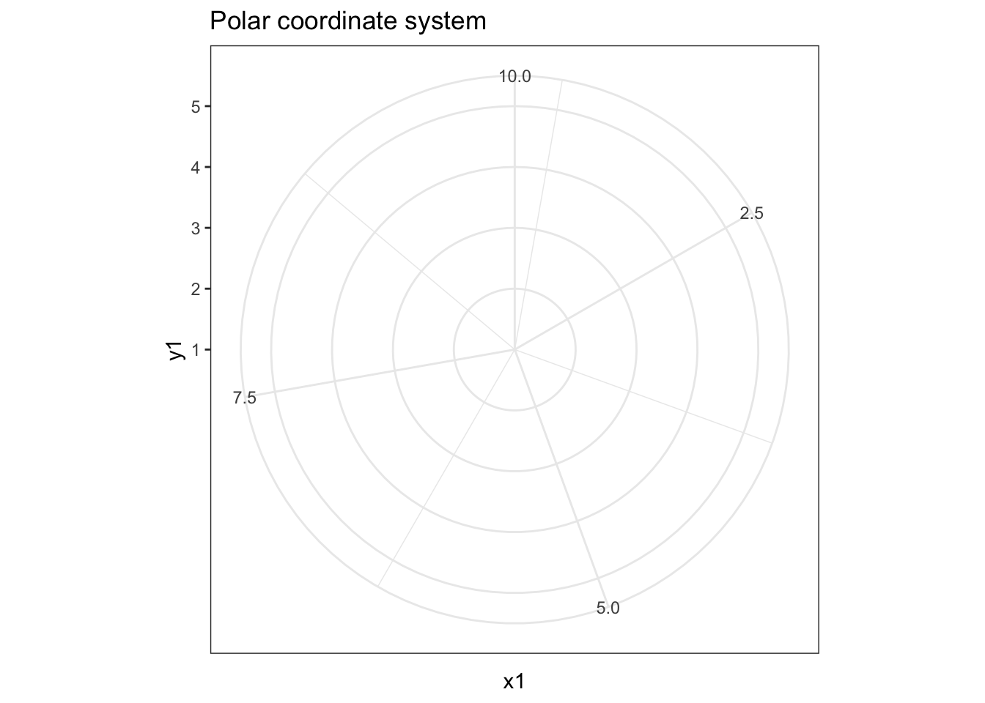
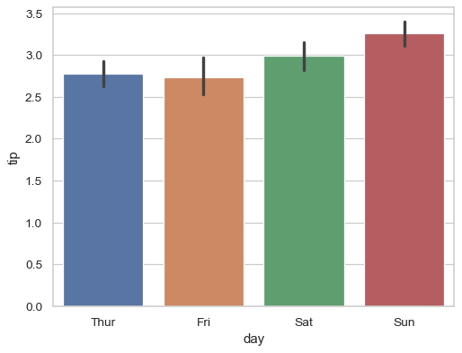
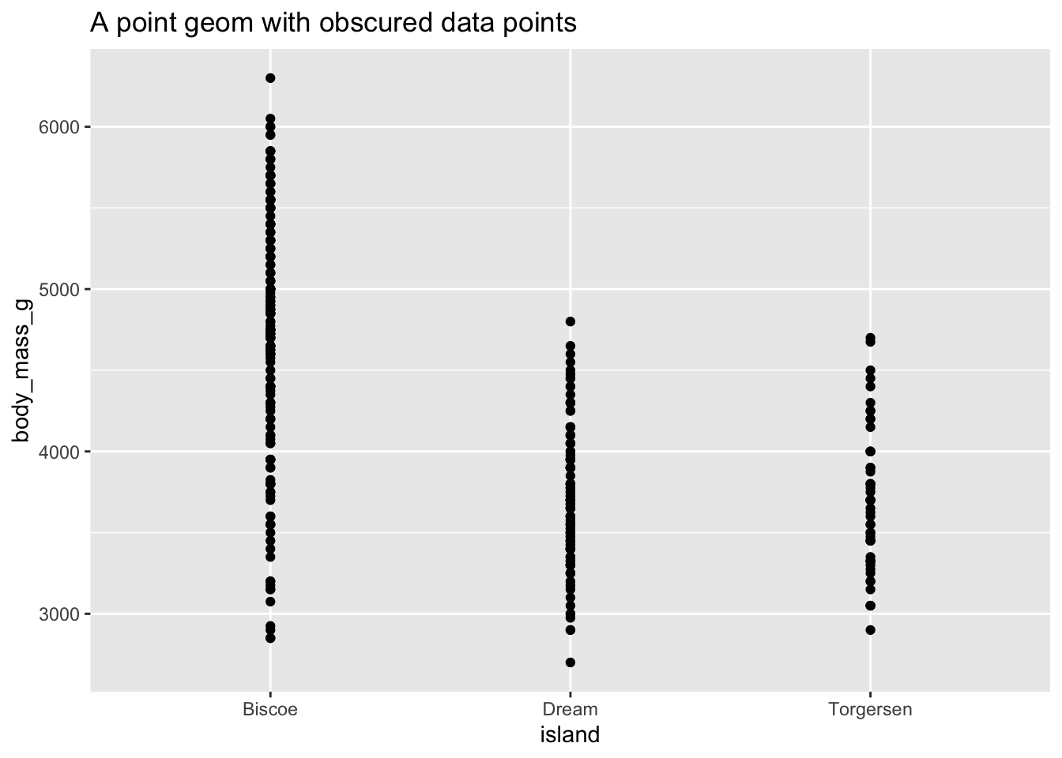
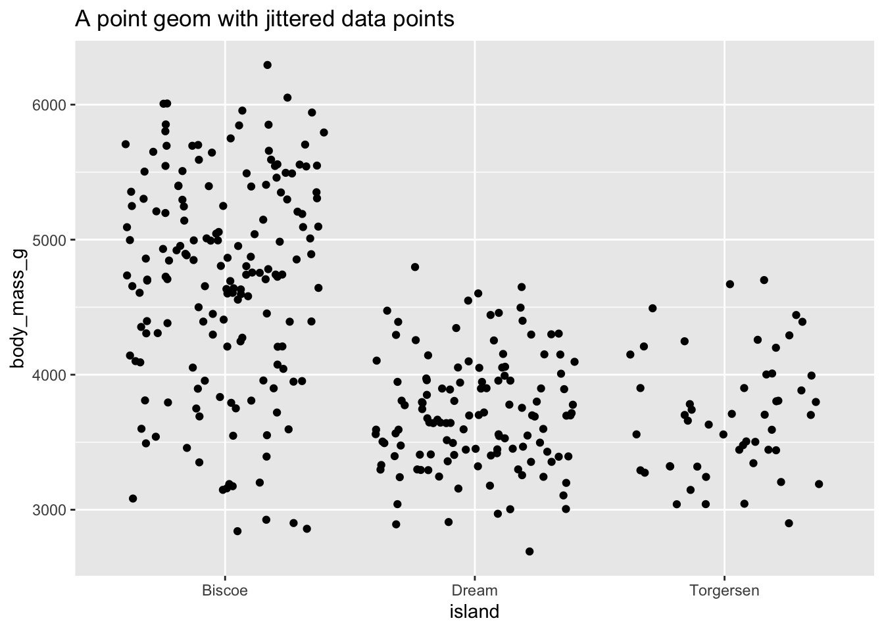
Components of the layered grammar
Layer
Data
Mapping
Statistical transformation (stat)
Geometric object (geom)
Position adjustment (position)
Scale
Coordinate system (coord)
Faceting (facet)
Defaults
Data
Mapping
https://tinyurl.com/gg2022uchic
Notes:
Layers are related to each other and share many common features. For example, multiple layers can be built using same underlying data – like a scatterplot overlayed w a smoothed regression line
Data defines the source of information to be visualized, but is independent from other elements
Mapping defines how variables are applied to the plot. (what is in x position, what is in y position?)
Stat – transforms the data. E.g. a bar graph, you are not graphing the raw data, but rather the mean and the SE. takes in a dataset as input and returns a diff dataset as the output.
Geoms – control type of plot you create. Classified by their dimentionality – 0 dimensions, point, text; 1 dim, path, line, 2d, polygon, interval.
Position adjustment e.g. stack, dodge to avoid bars overlapping.
Scale - controls how data is mapped to aesthetic attributes; e.g. color scale;
Coord- maps positions of objects onto the plane of th eplot, controls how the axes and grid lines are drawn. Usually 2 coordinates, but could be more. E.g. Cartesian (this one), or polar.
Faceting – can split the data up into subsets of the entire dataset. Allows subsets to be visualized on the sam eplot
Default – simplified grammar

Slide 9
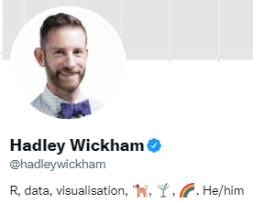
Ggplot2 is a package implementation of the layered Grammar of Graphics
ggplot2 is a powerful and a flexible R package, implemented by Hadley Wickham, for producing elegant graphics. The gg in ggplot2 means Grammar of Graphics.
tinyurl.com/gg2022layers

Slide 10
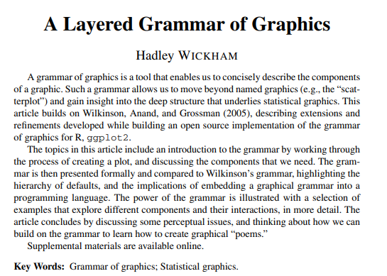
Ggplot2 is a package implementation of the Grammar of Graphics
ggplot2 is a powerful and a flexible R package, implemented by Hadley Wickham, for producing elegant graphics. The gg in ggplot2 means Grammar of Graphics.
tinyurl.com/gg2022layers

Slide 11
Pulling them all together
Running ggplot() creates a new plot object in the existing R language
Then you add layers, like an onion, specifying the data, mapping, geom & stat, position scales, and coordinate systems
Any aesthetics specified in the layer will override defaults
Notes:
Pg 15 from Wickham

Slide 12
Time to walk through some common graph types!
https://github.com/kirver/ggplot2

Slide 13
Some helpful links
https://rafalab.github.io/dsbook/ggplot2.html
https://towardsdatascience.com/a-comprehensive-guide-to-the-grammar-of-graphics-for-effective-visualization-of-multi-dimensional-1f92b4ed4149
http://r-statistics.co/Top50-Ggplot2-Visualizations-MasterList-R-Code.html

